Slide 1
ENSE 374, Milestone 4
Snow Bird
Ali Rizvi, Raymond Knorr,
Sana Khan, Zain Abedin,
Priscilla Chua, Li Pan
2018-11-15

Slide 2
Overview
Continuing from our content strategy proposal, we decided to keep the idea of an ever-present nav bar with the four main headers: Committees, Course Material, Research Areas, and Forms/Documentation. This nav bar would be on any of the nested pages within
Since the private site would require a user to login, the site’s security would be tied to this authentication.
This could either mean a base security level based on the user’s faculty, or specific permissions given to individuals

Slide 3
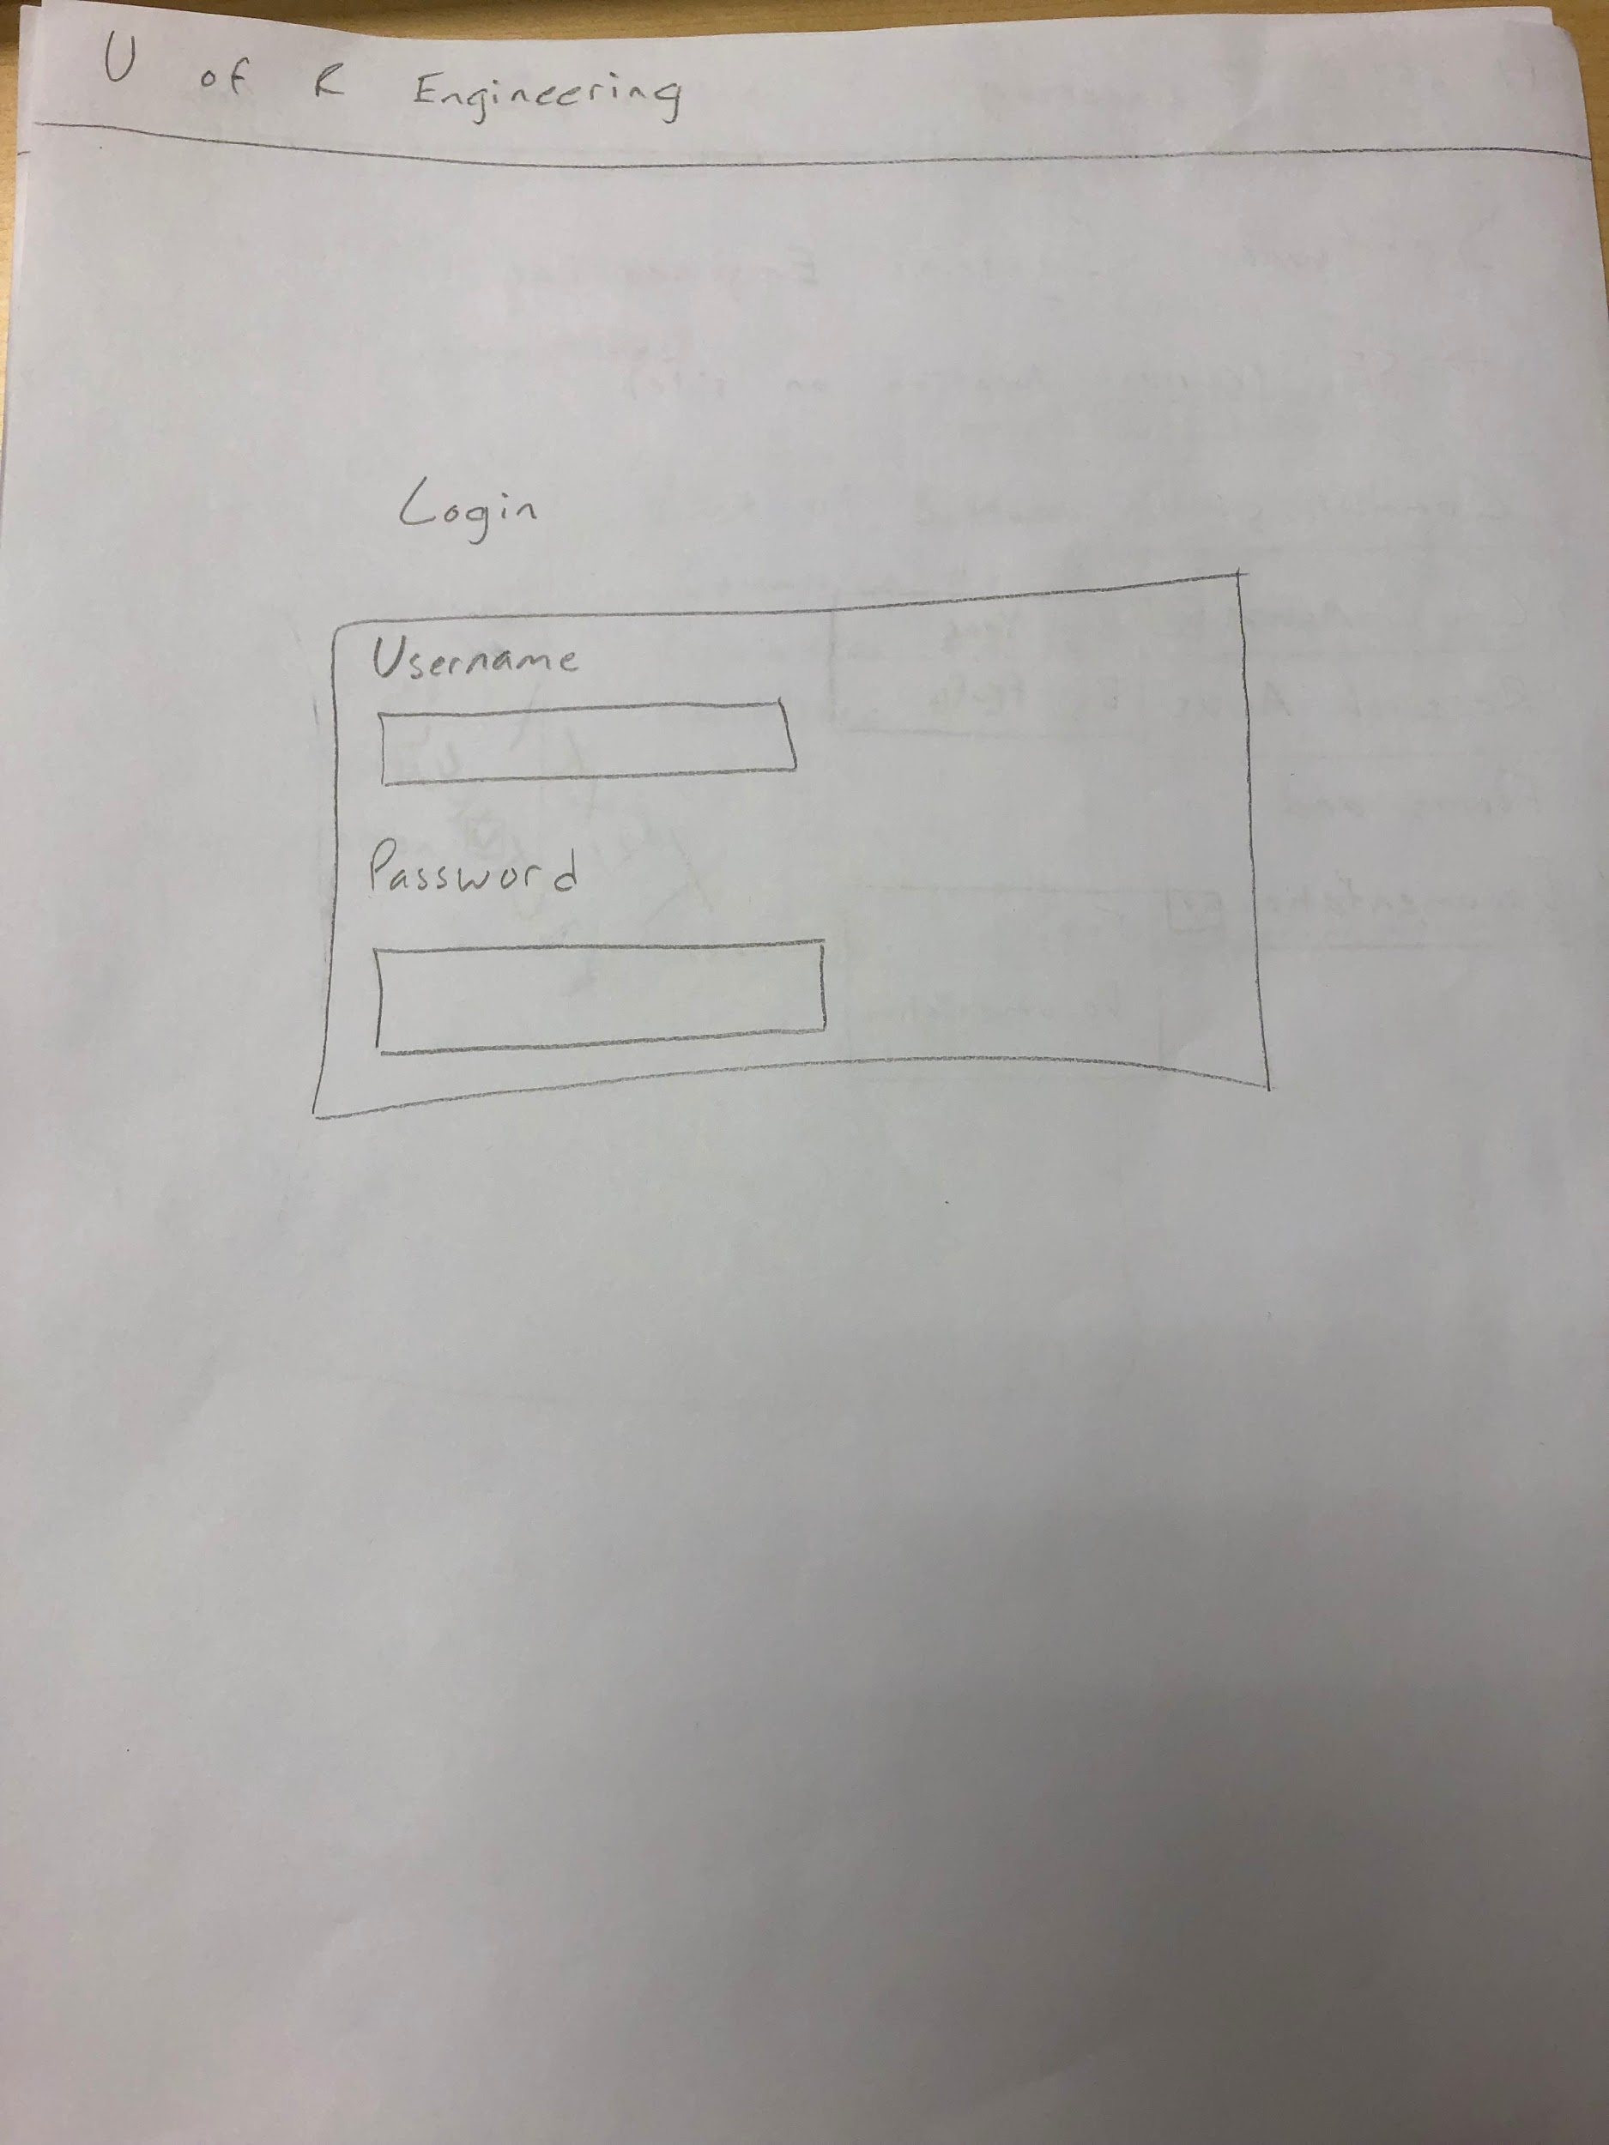
Login Page
Would be a simple form page necessary to validate the user’s credentials
The user would be directed to their respective faculty once they are authenticated

Slide 4
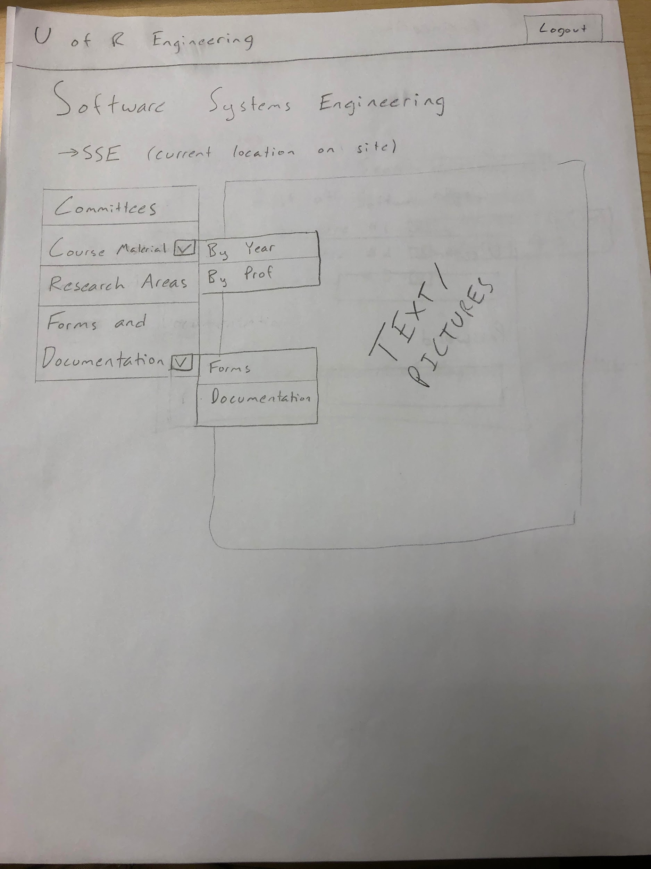
Main Page (Faculty)
The main page will contain any default information available for the faculty’s staff, as well as a nav bar that will contain the four main headings
The nav bar will have two dropdown menu options, that simplify the navigation to the respective pages

Slide 5
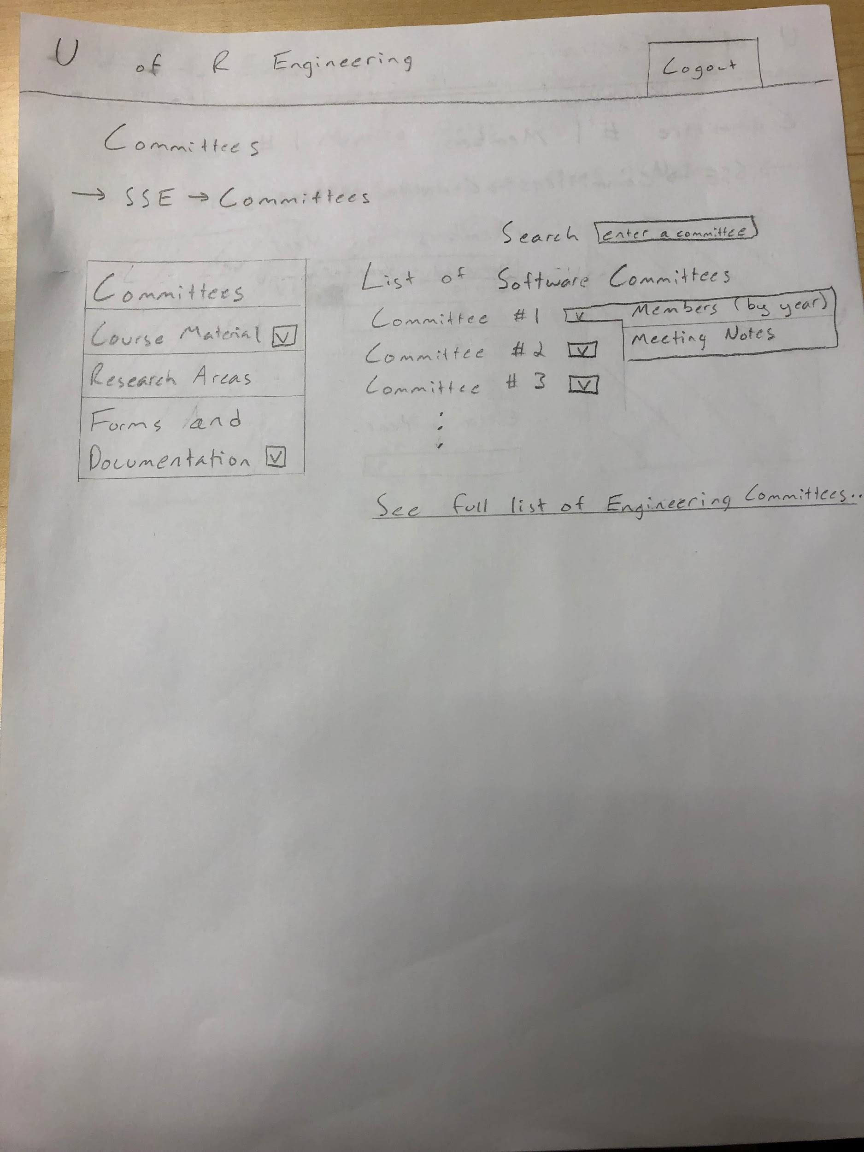
Committee Main Page
Contains a list of faculty-specific committee items corresponding to individual committees, where each contains a drop-down
The drop-down menu contains the option to either see the historical record of the committee members, or to see the meeting notes
The page also contains a link to a full list of all committees in engineering

Slide 6
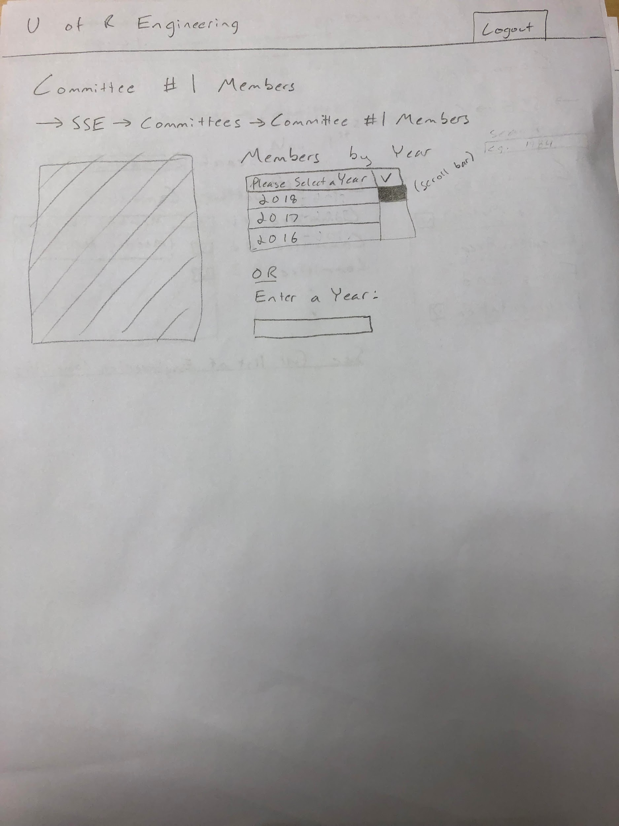
Committee Members
Contains a list of the committee’s members, organized by year. With a possible option to enter the chosen year directly
The nav bar containing the four headings is still present, but is not detailed in further pages

Slide 7
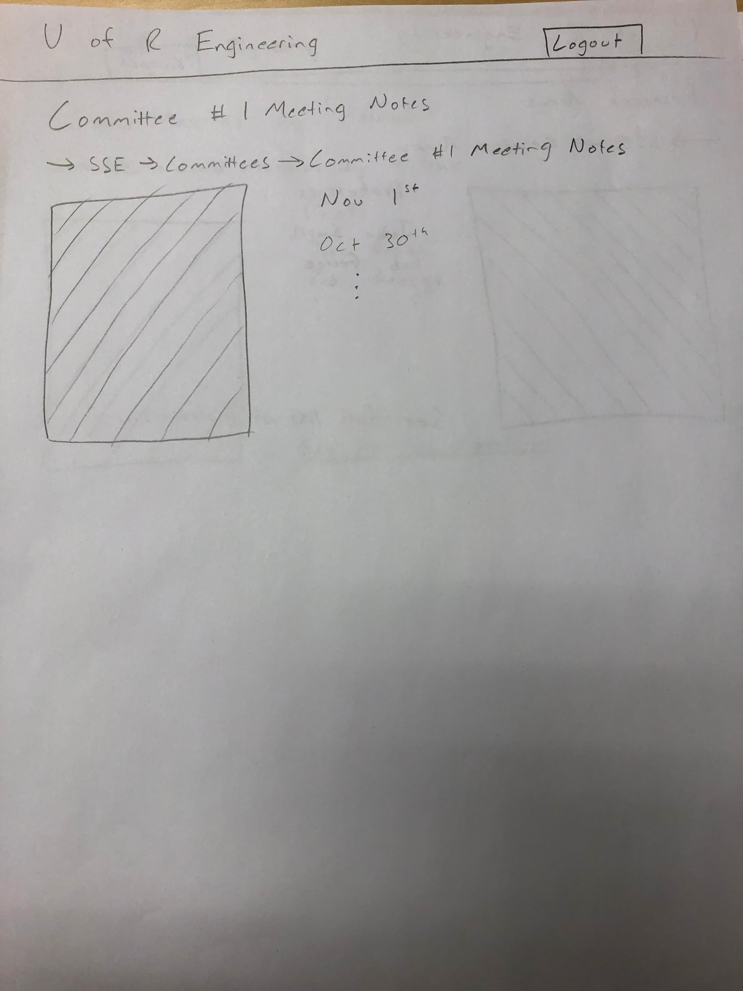
Committee Meeting Notes
Contains a list of folders containing the individual meetings notes
Sorted in reverse chronological order
Could have further classification of meetings based on topics covered

Slide 8
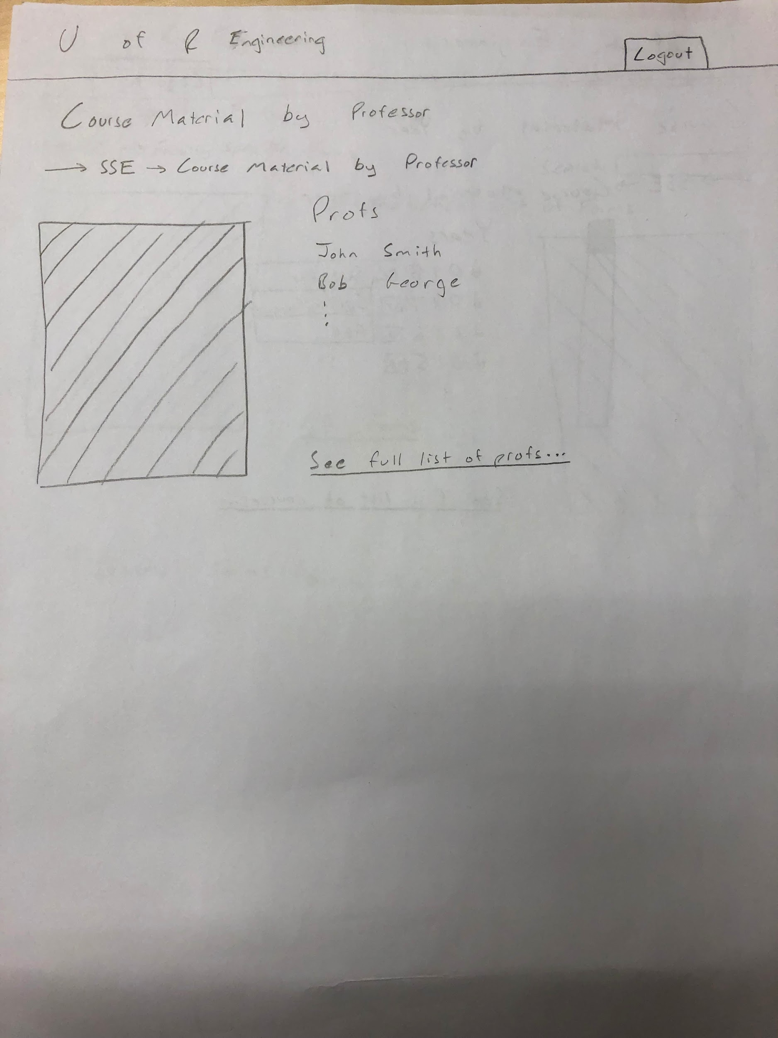
Course Material by Prof
One of the two options given to sort the given courses
Provides a list of professors in the faculty, linking to lists of the courses that they teach
Has an additional link to view a full list of professors in engineering

Slide 9
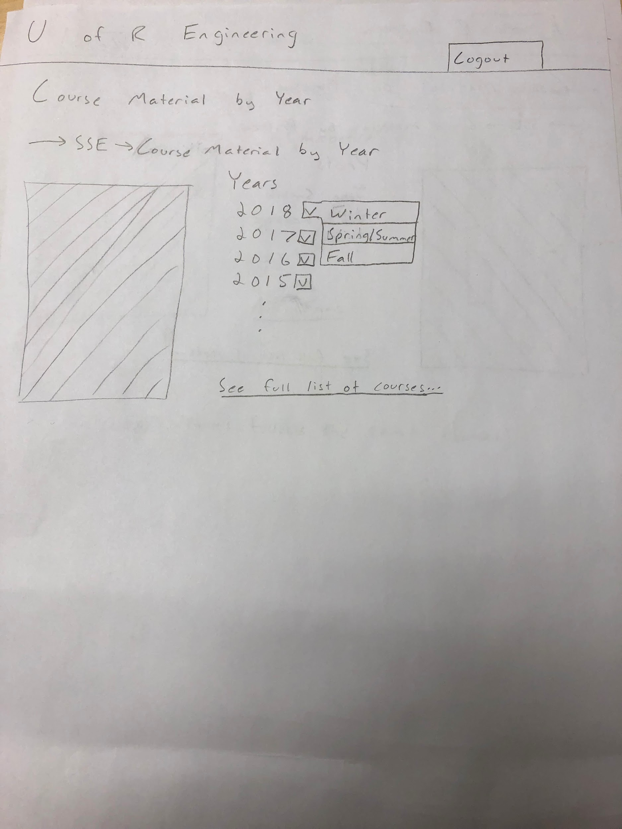
Course Material by Year
Provides a list of dropdown menus, corresponding to the year, and then the semester that the course is offered in
Links to a page containing all of the courses offered in that semester (in the sub-faculty)
Contains a link to a list of all courses in engineering, sorted the same way

Slide 10
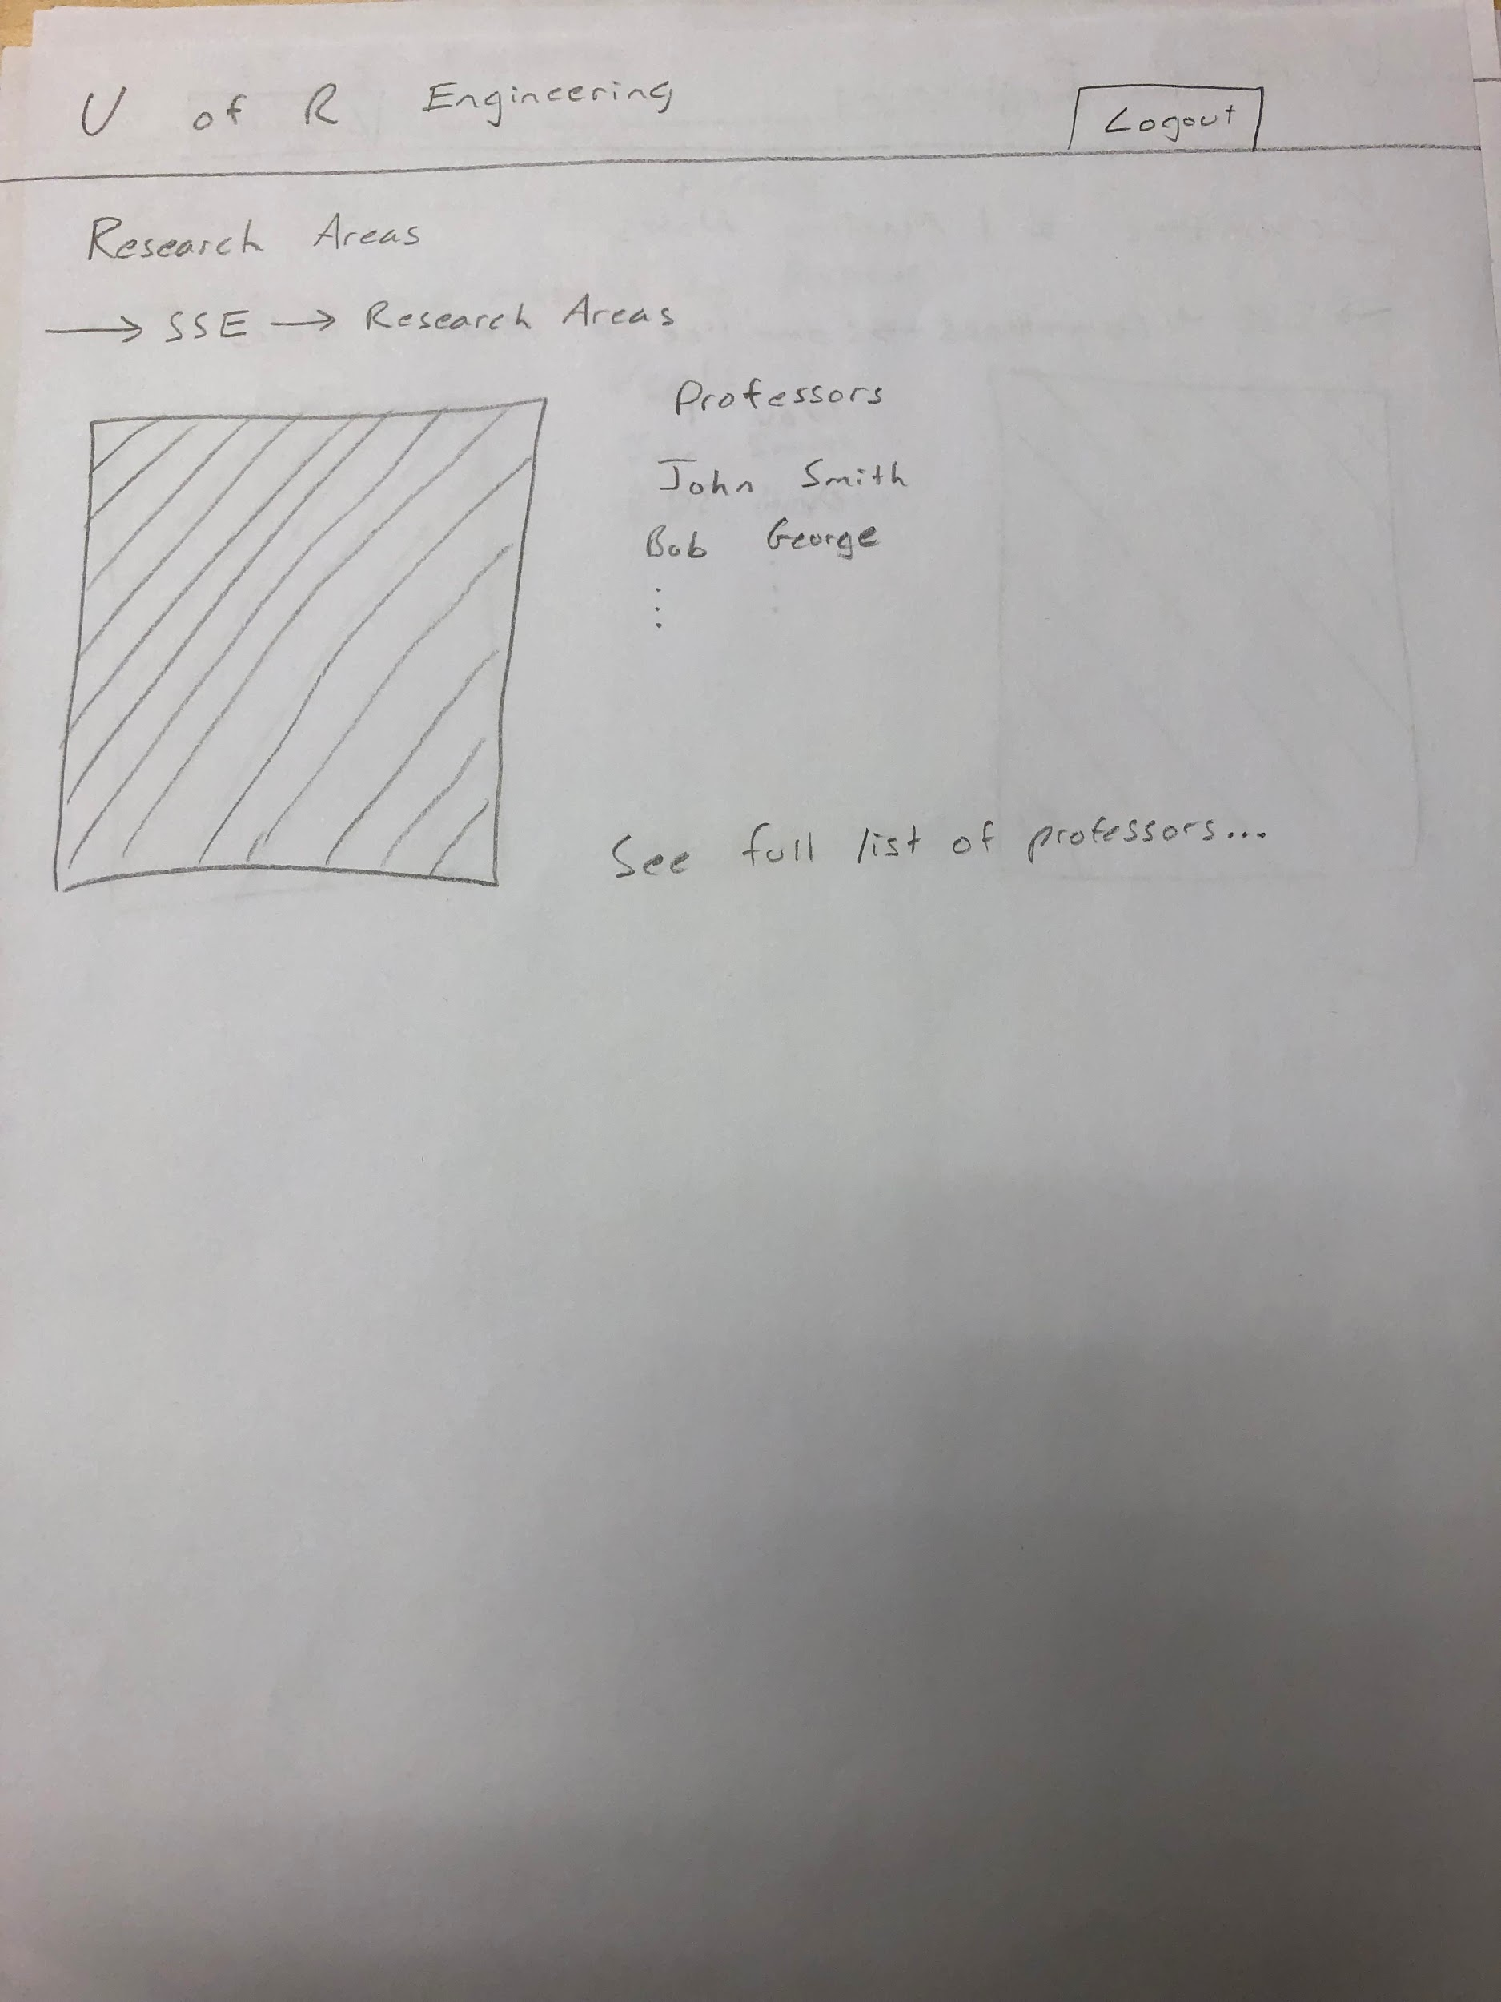
Research Areas
Research areas are sorted by professor, with the default page showing only the professors of the sub-faculty
By clicking on one of the professors, the user would be directed to the research done by that professor
Any of the list items could also include short summary of the professors personal research areas

Slide 11
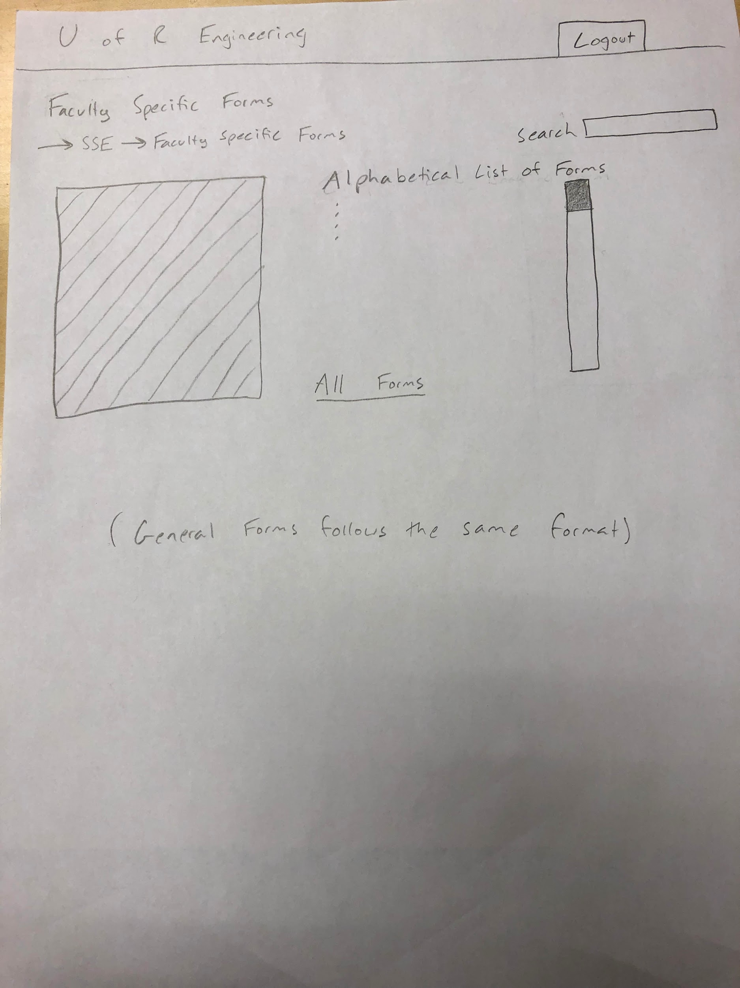
Forms
Faculty Specific Forms are provided in alphabetical order
Will include a link to a General Forms page for any forms not specific to the faculty
Each of these pages provides the user with a search bar to find forms immediately

Slide 12
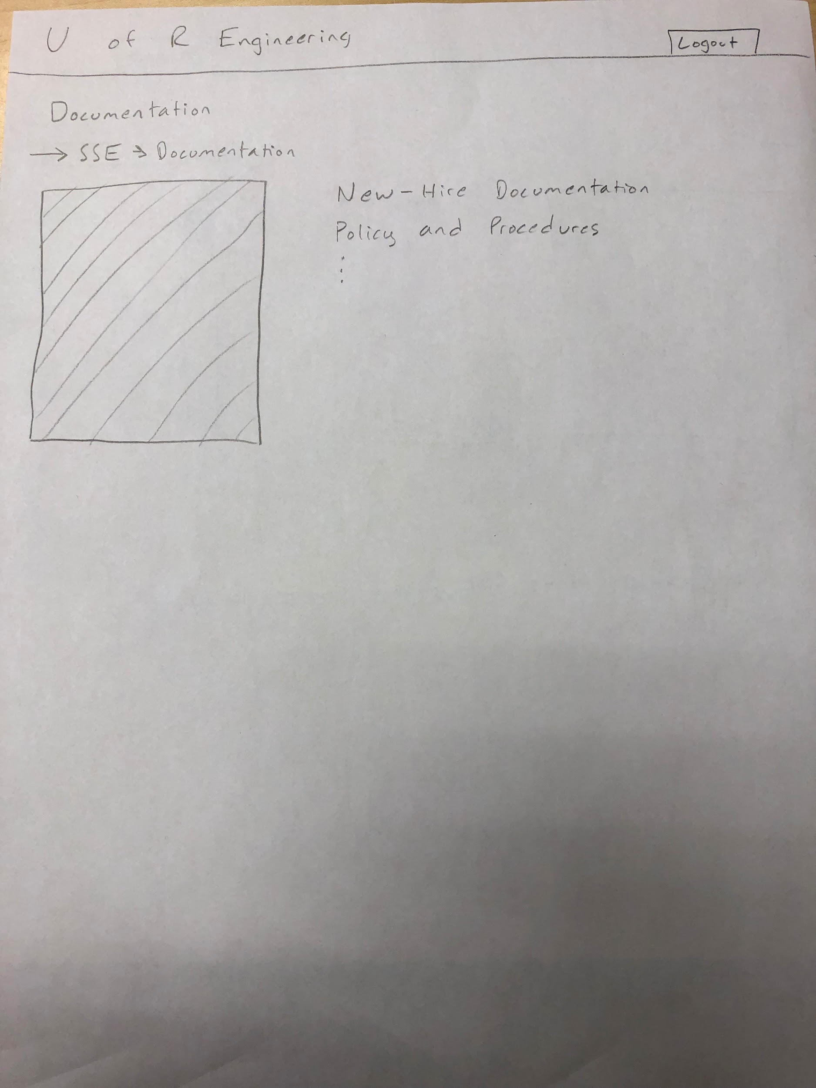
Documentation
The Documentation site page provides folders that would have individual documents within them
Two of these folders would be ‘New-Hire Documentation’, and ‘Policy and Procedures’
Should also include a link to a general documentation folder

Slide 13
User Questionnaire: Pre-task Questions
Do you think you would prefer to see more options on the same page with the potential for less click throughs? Or would you prefer the opposite?
This would be the closest the tester could get to an unbiased opinion of the users ideal navigation experience

Slide 14
Task Questions
Where would you go if you were searching for a specific course syllabus?
Would reveal whether the user chose to search by professor or by semester.
Can you attempt to find the page that would include lab safety procedures documentation?
Tests if the documentation tab makes logical sense to a first time user.
The tester would also glean many key insights into what the user is thinking while moving through the site.

Slide 15
Post Task Questions
How would you rate your ability to navigate the pages on a scale from 1-10?
What is the most important feature that you think is missing, or that we need to add?
Are there any parts of the web page structure or navigation that did not make sense?

Slide 16
Cascade Server Progress
We did not extensively test the usability of the Cascade Server
However, we noticed that a lot of the functionality is similar to the public site investigated in Milestone 2. This includes the presence of the navigation path on each page, as well as the use of dropdown menus

Slide 17
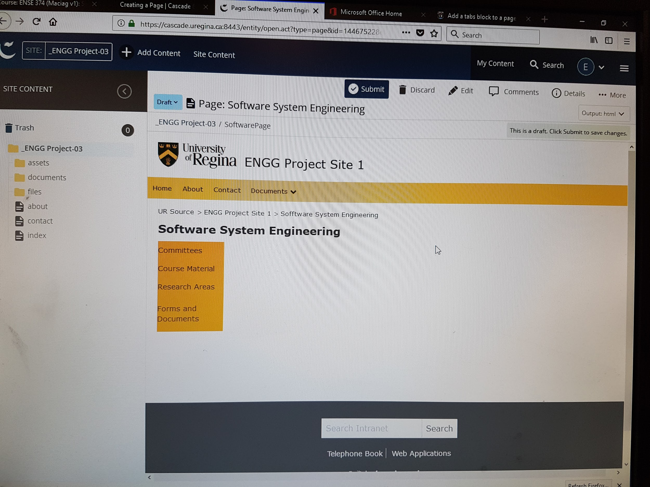

Slide 18
Group reflection
How did you feel about this milestone? What did you like about it? What did you dislike?
Using paper graphics to directly display our ideas
We realize there is room to improve, however we are getting close to being done
What did you learn about yourself as you collaborated and worked through this milestone?
Brainstorming ideas from everyone helps a lot
This milestone is vital to the success of our project
How will you use what you have learned going forward?
Balance the expected needs from different users
What “stuff & things” related to this milestone would you want help with?
Spend more time to do the research and plan

